Slide 1
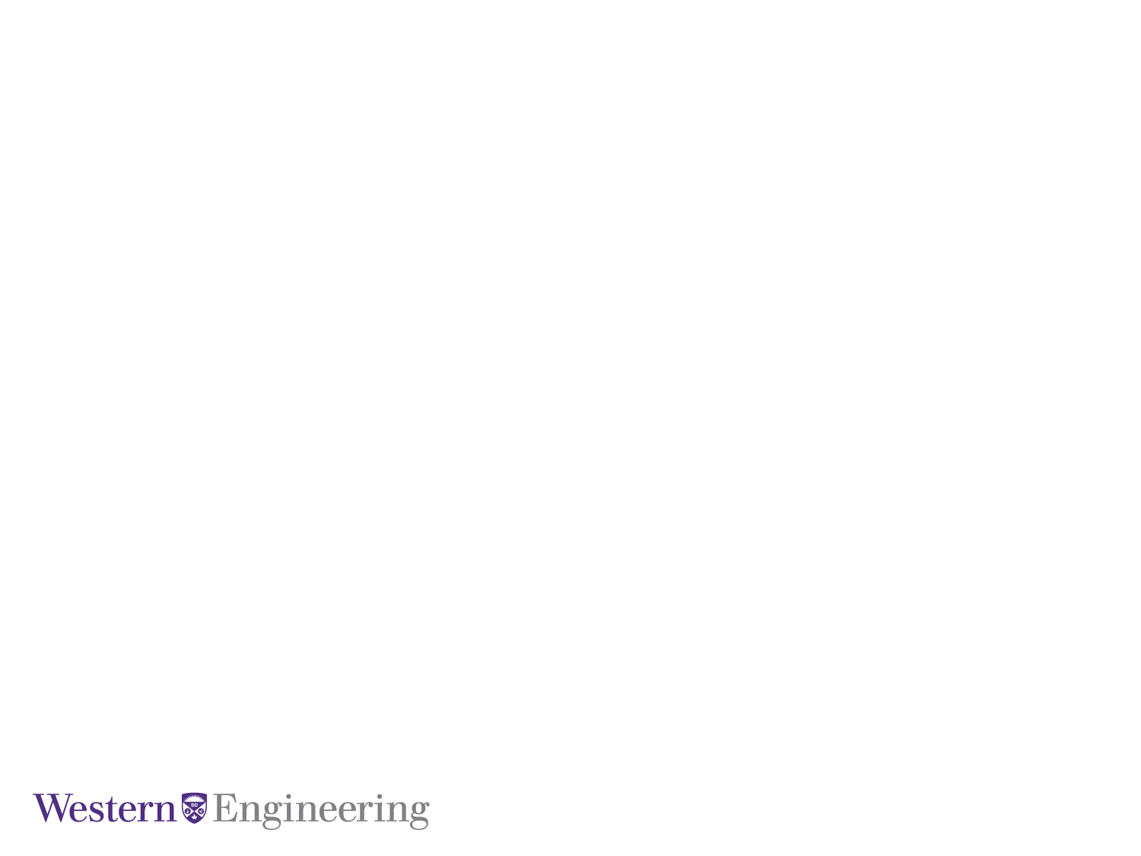
Feature Encoding Strategies for Multi-View Image Classification
M.E.Sc Candidate: Kyle Doerr
Supervisor: Dr. Samarabandu
Co-Supervisor: Dr. Wang
January 26, 2016
Electrical and Computer Engineering

Slide 2
Outline
Motivation
Contributions
Background on image classification
Feature Encoding techniques
Triangulation Embedding
Results
Conclusion
Future Work
Notes:
find better names or something

Slide 3
Motivation
Recent advances in computer vision
Limited active research on machine vision problems
Many manufacturing industries still rely on human inspection
Notes:
-Past several years there has been considerable advances in CV with respect to image classificaiton & retreival
-Limited work applying CV to MV
- …. ....
-Many <industry, factory? > rely solely on humans for tasks such as identification and defect detection which is error prone
- ….. ... . ..
Recent advances in computer vision:
-specifically for classification & retrieval
- feature encoding techniques
-CNN brought on by gpu computing
Limited active research on machine vision problems – that is using lower level techniques for the purpose of object identifcation and defect detection in manufacturing settings. With the recent advances in CV the MV field has been fairly stagnant with no attempt to bridge the gap between the two
Many manufacturing industries still rely on human inspection – many places still employ humans for inspection for a variety of reasons:
-resistance to change
-fear of cost with MV systems
-

Slide 4
Contributions
A machine vision framework that can classify very similar automotive parts:
High classification accuracy is required to be useful in manufacturing environments
Near real-time classification
An evaluation of feature encoding techniques:
With multiple view data
Results that generalize from machine vision to computer vision problems
Notes:
A machine vision framework that can classify very similar automotive parts:
-for a vision system to be useful in manufacturing settings high classification accuracy is required. MV often need 99%+
-for a system to be useful it also needs to classify near-real-time or at the rate of production
The second contribution is an eval of feature encoding …
-used in-house dataset multiple views taken at a single point in time
- and publically available dataset that is more traditional to CV problems

Slide 5
Contributions
A new object classification framework using binary ORB features that can classify very similar automotive parts real-time and provide a meaningful, robust solution for manufacturing environments
A low cost view vision system using web cameras that can handle missing input
Notes:
-A machine vision framework that can classify very similar automative parts in
- Can classify near real time
- High classification accuracy to be useful in manufacturing environments
-An indepth comparison of binary features (ORB) to traditional SIFT and SURF image features
- …
-A demonstration on advanced feature encoding techniques for fine-grained image classification that generalizes to MENTION CALTECH
-An object classification framework using binary features that can classify very similar automative parts in near real-time
-A cost effective machine vision system that is robust enough for industrial applications:
-Used inexpensive webcams
-Robust enough that <high class acc> in event of damaged camera

Slide 6
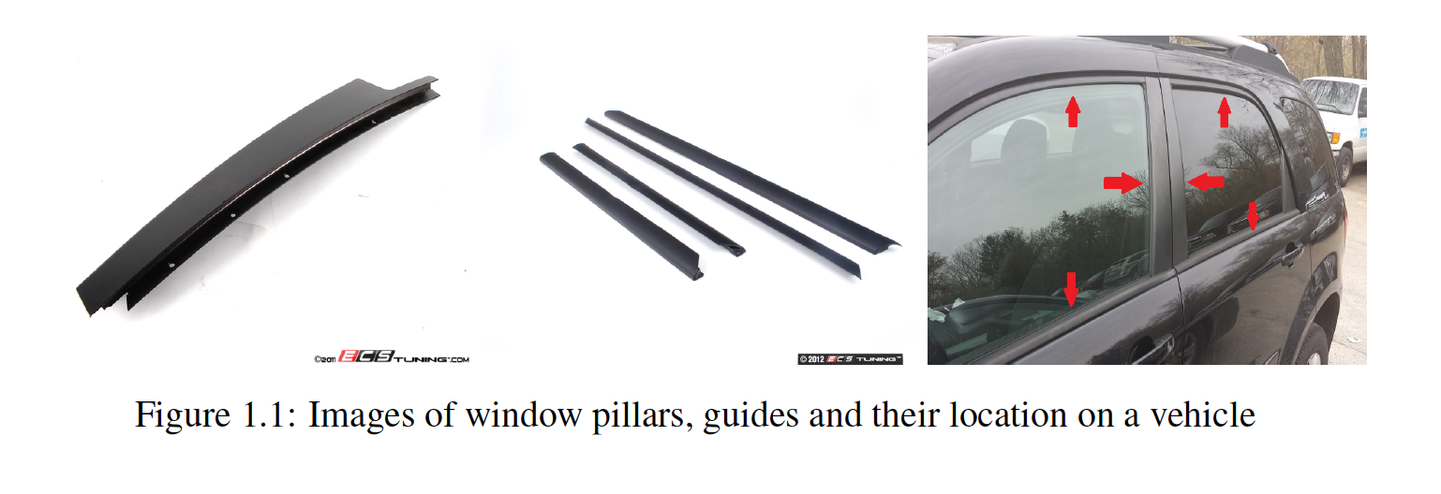
Introduction to the Problem
The problem focuses on the correct classification of window pillars and guides
Poke-yoke system
Notes:
-The problem focuses on correct classification of window pillars and guides (see fig1.1)
-Tthese types of parts are particularly challenging to label correctly
-> this is where they are located on the car
-> mention confidentiality aggrement

Slide 7
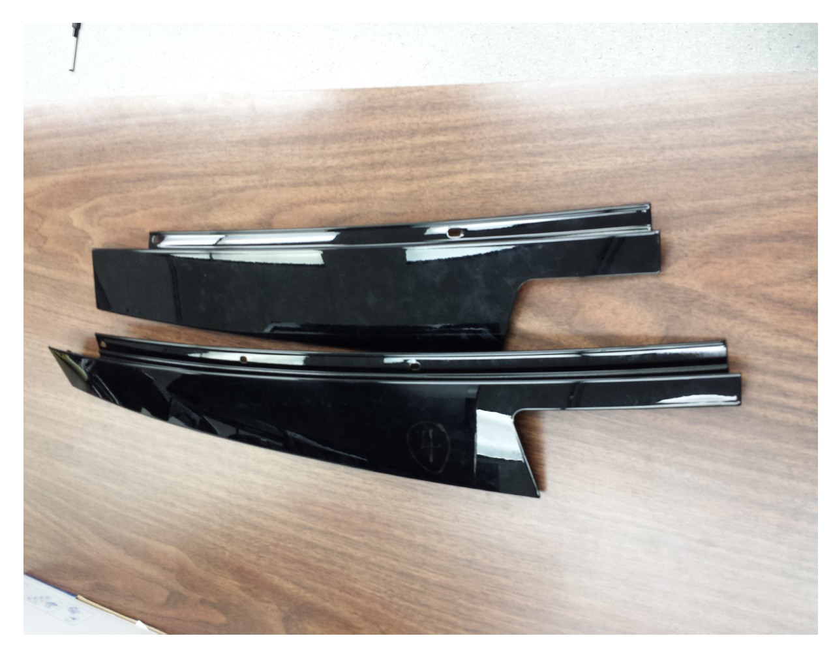
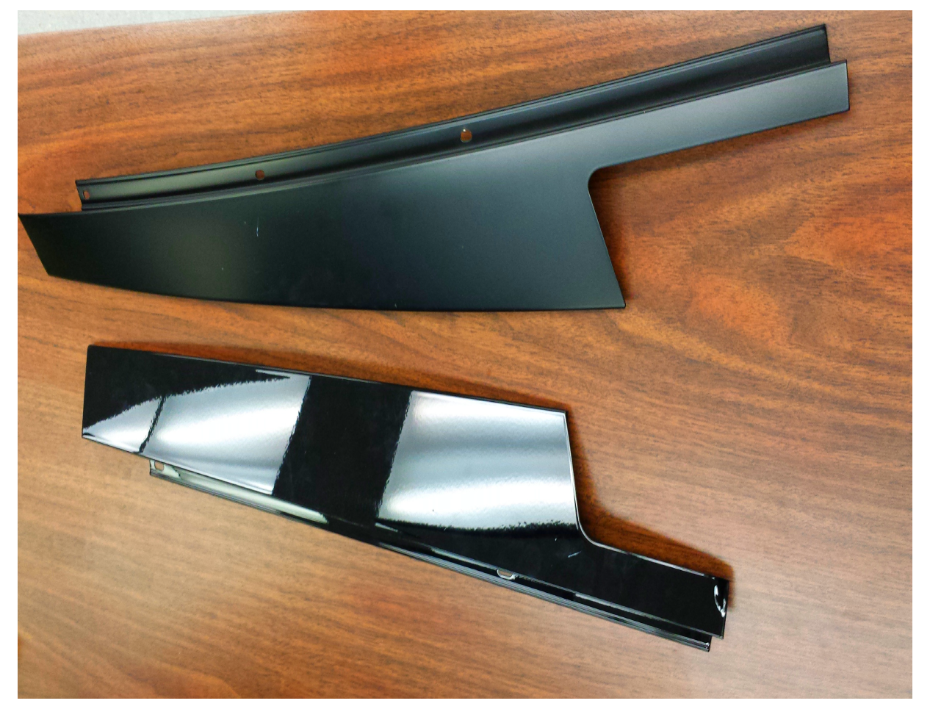
Introduction to the Problem
Variations in length, orientation and luster
Notes:
-results in numerous combinations as the side of the vehicle and front vs backwindow
-first image, changes in length for front vs back
-second image orientation for left vs right side

Slide 8
Introduction to the Problem
A typical automotive plant can manufacturer several thousand of these parts a day
Previously, correct labelling of these parts was left to humans:
Difficult to identify small similarities on a moving belt
Human fatigue during an 8+ hour shift
More than one vehicle make with several models
Notes:
-A typical plant can manufacturer thousands of these parts a day
-These types of autoparts have minimal variations in size, orientation, texture and luster … yet the parts must be correctly labelled during the vehicle assembly or for replacement parts
The plant where this system was deployed employs humans to identify the parts but frequently mixups were taking place
->Difficult to identify small similarities on a moving belt
->Human fatigue during an 8+ hour shift
->More than one vehicle make and several models
High rate of human error is costly
->the plant has to absorb the associated costs of shipping incorrectly labelled part
->lack of qualitiy control leads to unsatisfied customers

Slide 9
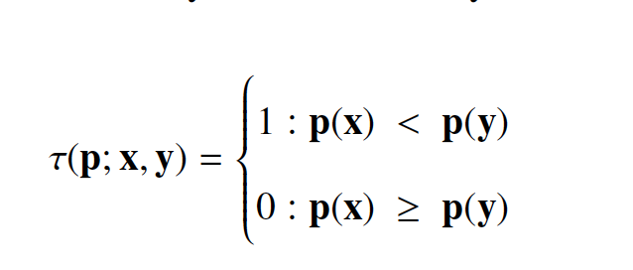
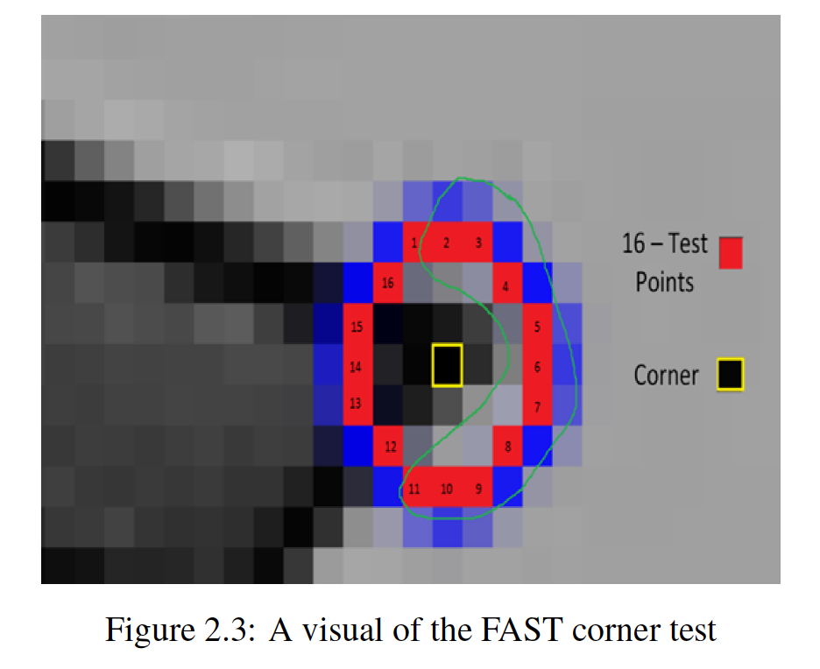
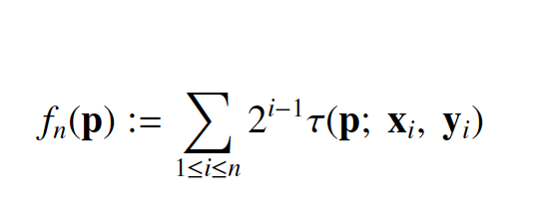
Background: ORB Features
Perform feature detection by finding corners
Using a pre-defined sampling pattern compare patches, patch p at point x to build the descriptor
Notes:
-ORB features are a type of computer vision feature
-Corners are identified by comparing a pixel to n-connected neighbours within a circle ring. If the difference between the possible corner and all n points is greater than or less than a threshold -> mark it as a corner
Using a pre-defined sampling pattern compare sampled sub-patches p at point x to build the descriptor. This generates a bit string

Slide 10
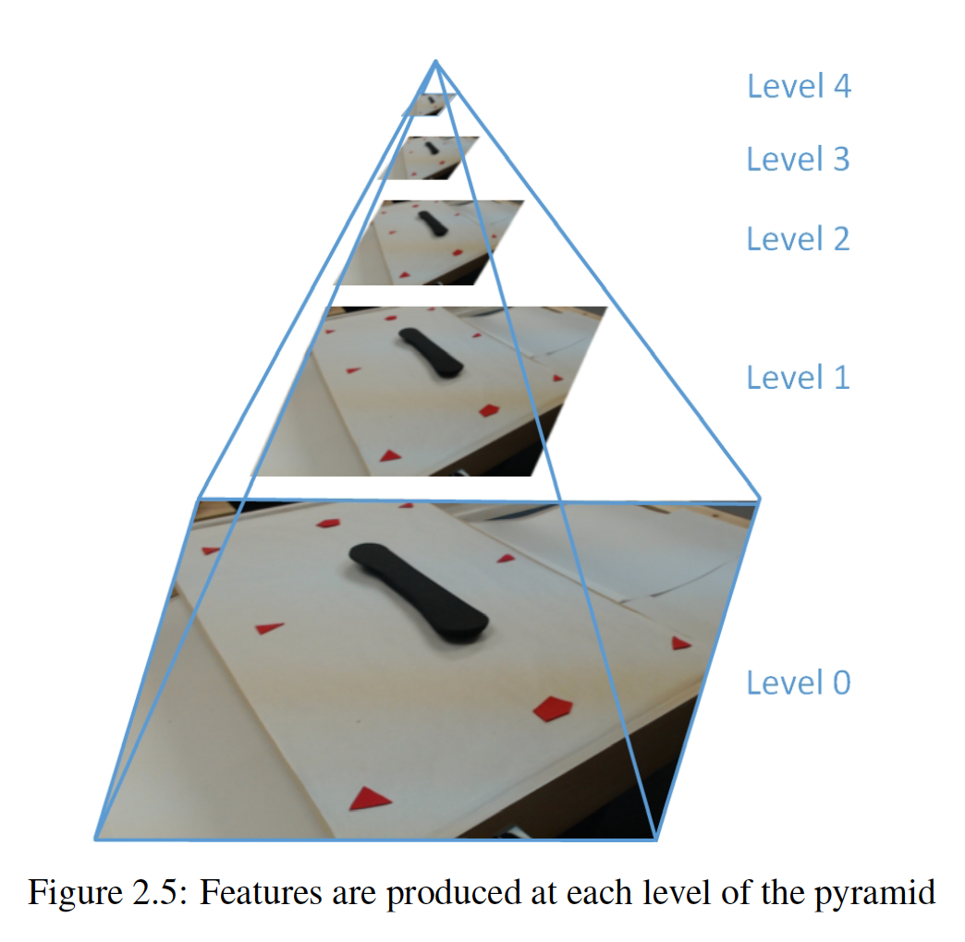
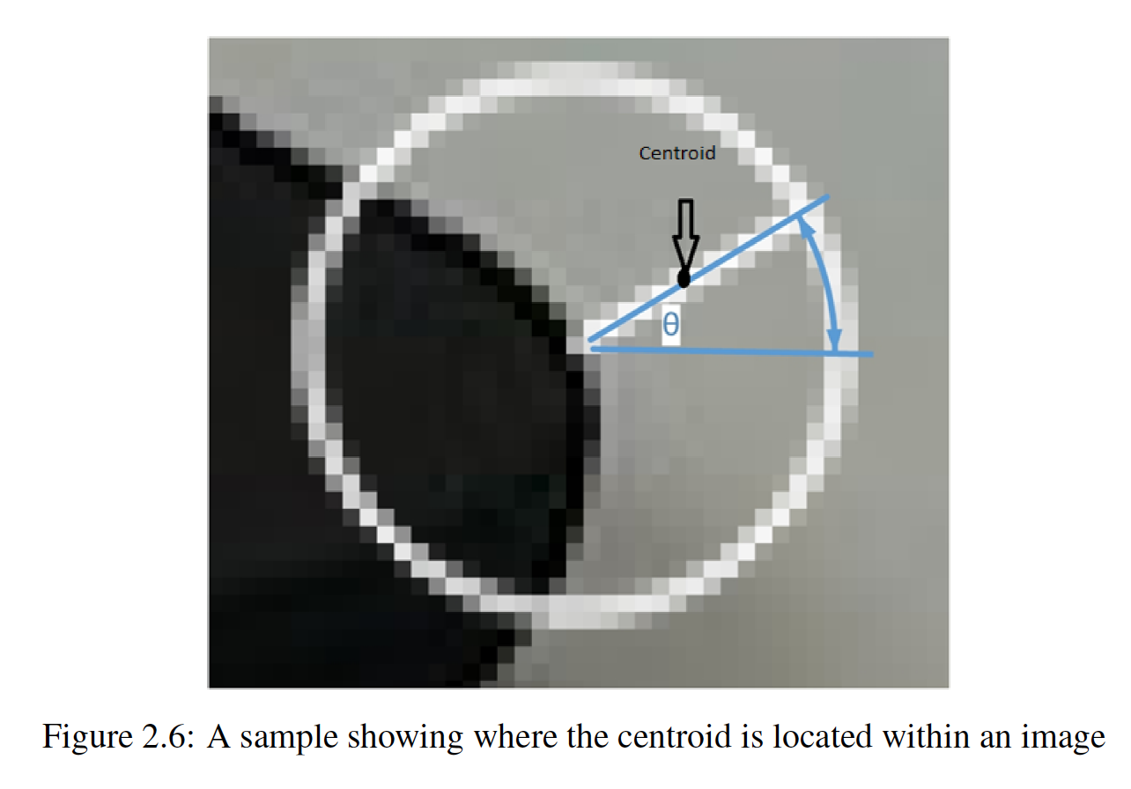
Background: ORB Features
Rotational Invariance by rotating the sampling points by an intensity centroid
Scale invariance by performing this process using image pyramids
Notes:
-ORB features achieve Rotational Invariance by rotating the sampling points by an intensity centroid - > naturally one would want features to match features across images even if the scene was rotated
-Matching a scale is done by performing feature extraction on downsampled images – allows for matching at different scales

Slide 11
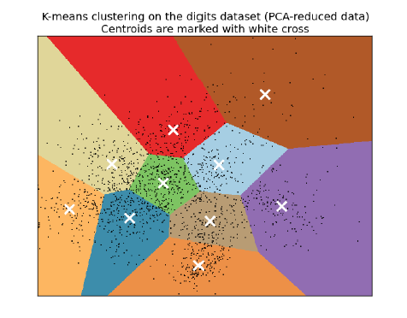
Background: Bag of Words
On an offline dataset perform feature extraction on a set of images to build a feature set
Run the unsupervised K-means clustering algorithm to construct the Visual Vocabulary
The centroids form the visual words

Slide 12
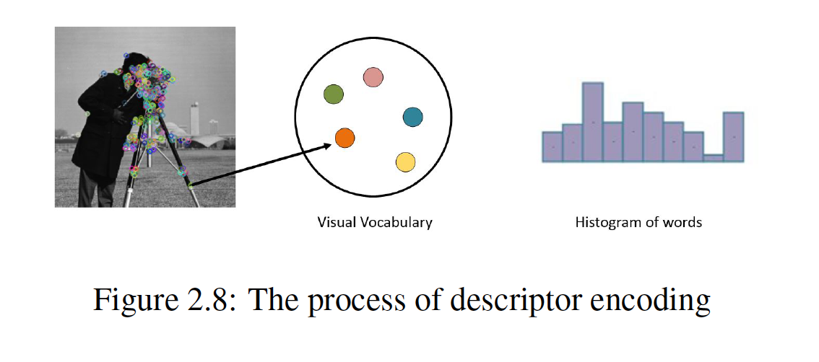
Background: Bag of Words
The formulation of the visual vocabulary now allows for building a training set
Features are matched to centroids by Nearest-Neighbour assignment
Notes:
-Assign features on an image to its most similar visual word , which is also known as the centroid
-build a histogram of how many centroids were matched to
-this is also refereed to as histogram encoding

Slide 13
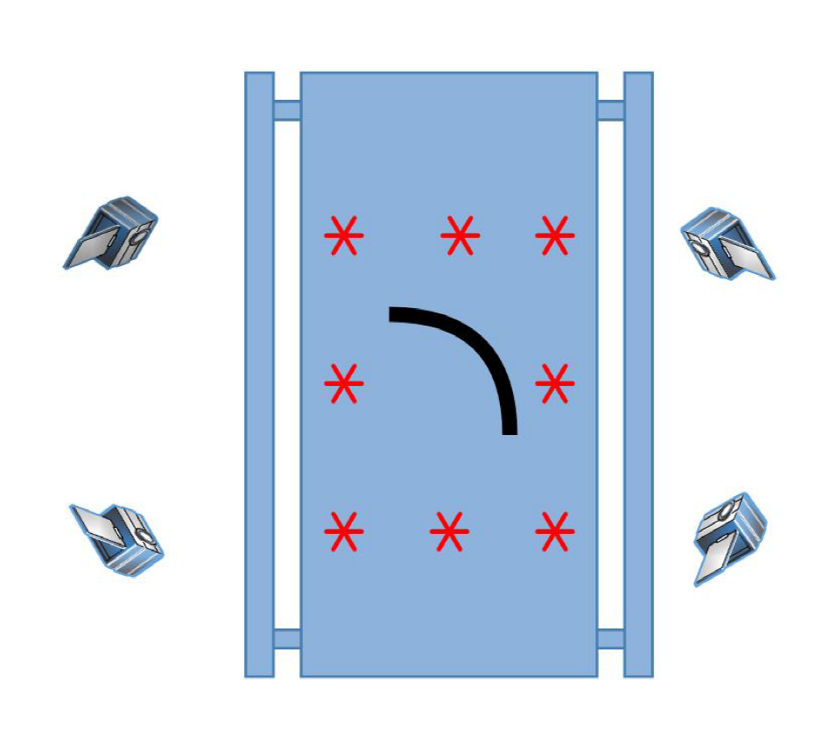
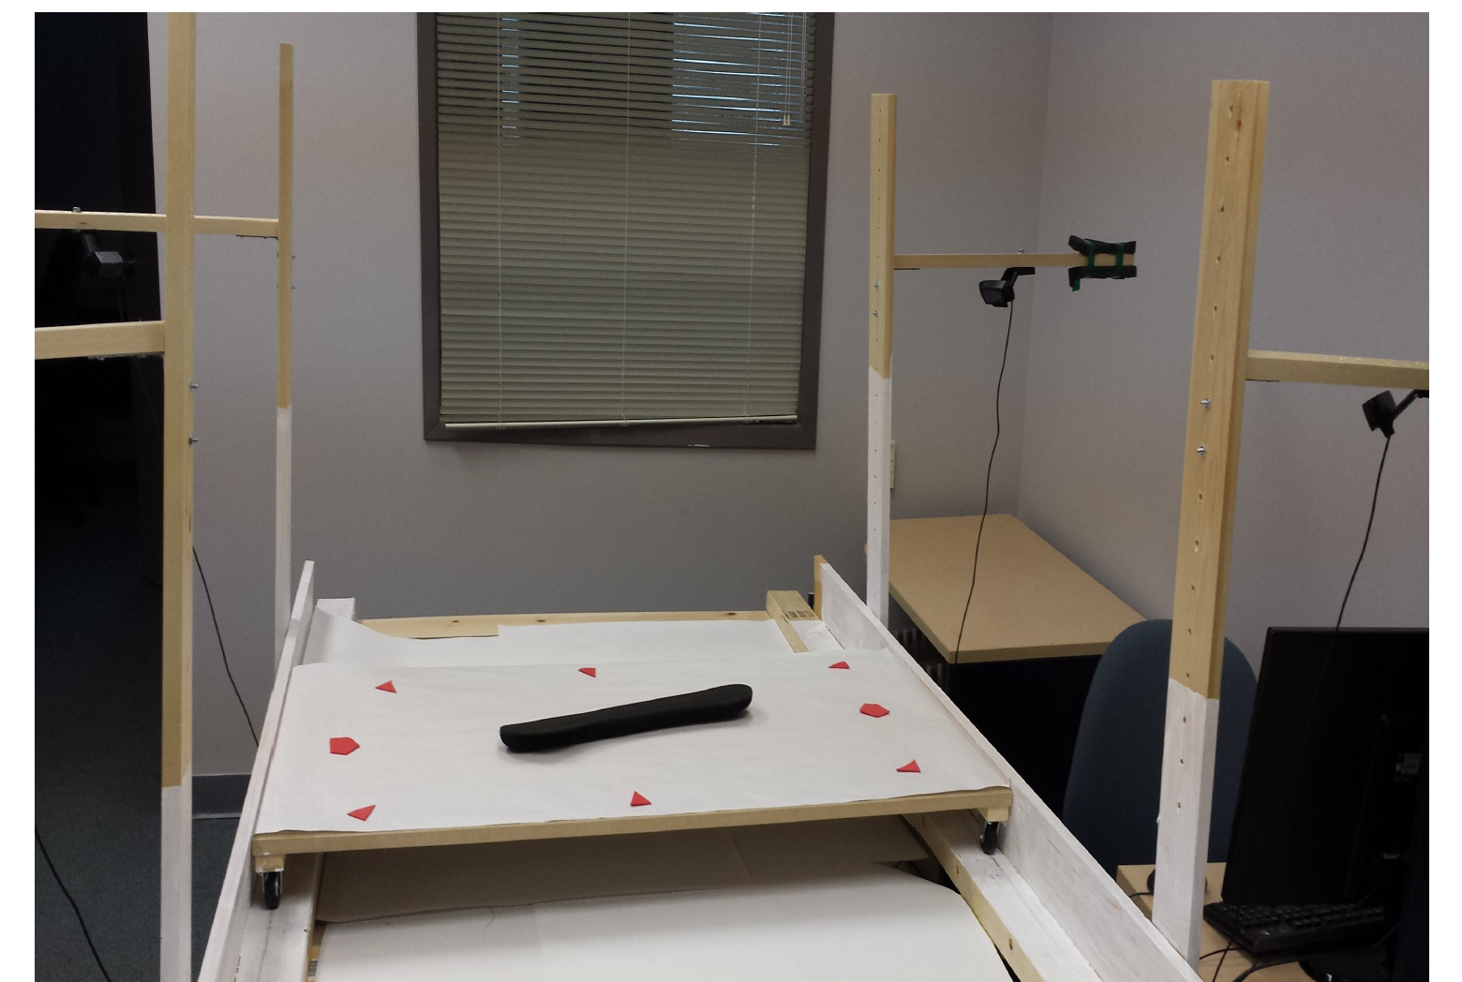
Proposed System
Notes:
-with the background of BoW out of the way.. The proposed system uses four overhead cameras
-commerically available

Slide 14
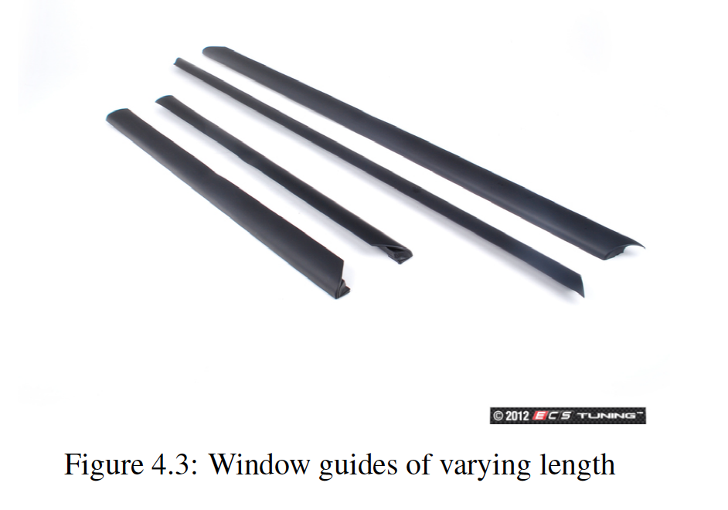
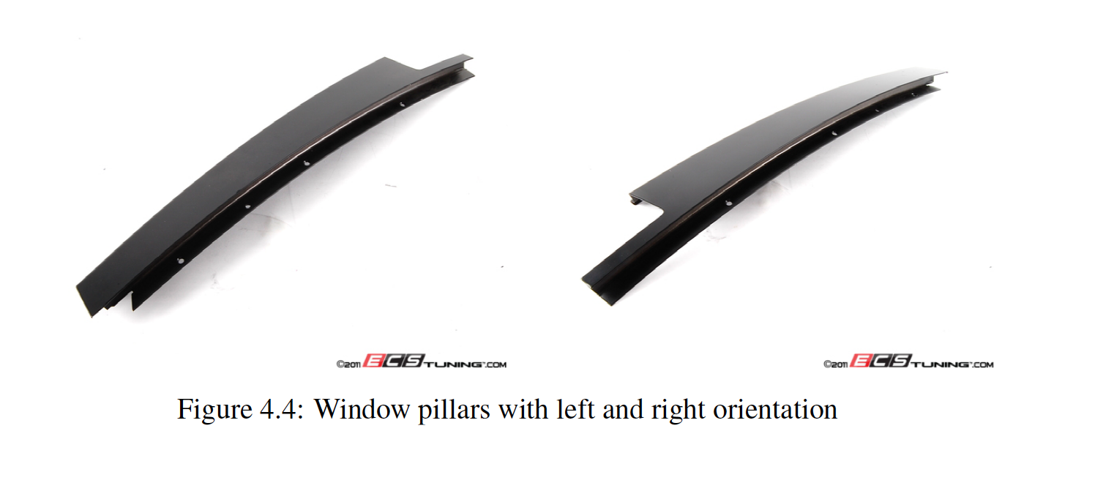
Datasets – in house
-39 classes of automotive parts – window & guides
-Differences in length, orientation, and luster
Notes:
-b/c of confidentally can’t show specific parts – but all were pillars and guides
-

Slide 15
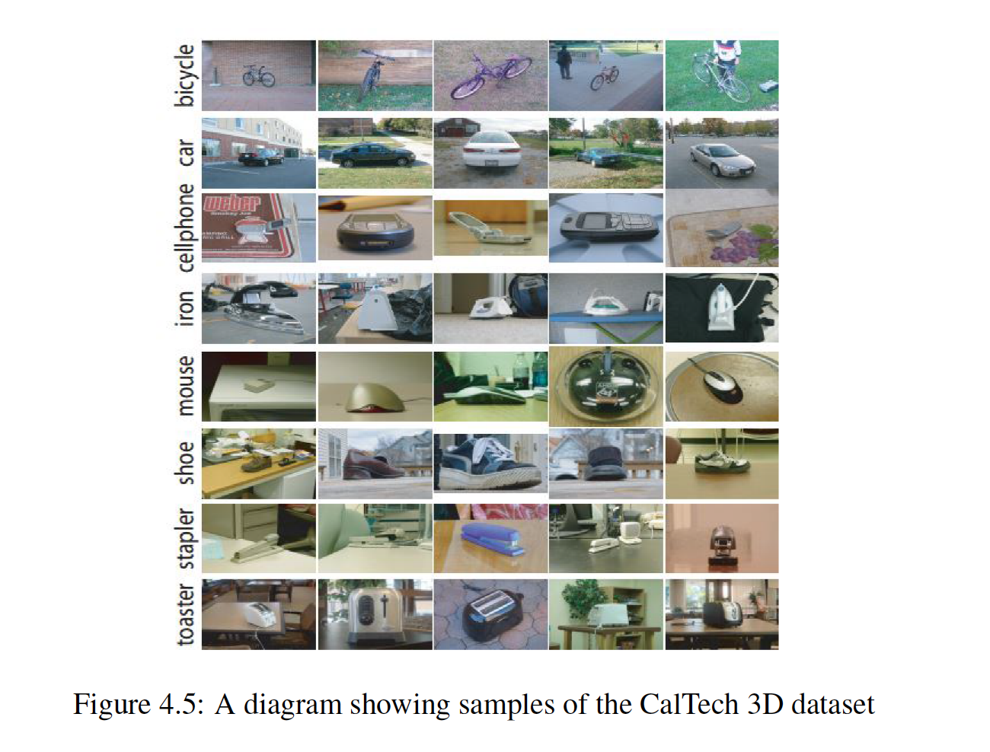
Datasets – CalTech3D (Fei et al.)
8 view dataset with 8 object categories
10 object instances with varying heights and scales
Notes:
-Caltech 3D
8 view dataset with 8 object categories
10 object instances with varying heights and scales
-Purpose was to show how the results on the autopart dataset generalizes to a more traditional CV dataset

Slide 16
Problem 1 – Feature Selection
How does the selection of feature types affect classification performance?
ORB, SIFT, SURF
Notes:
-Feature selection – how does this binary descriptor ORB compare to SIFT and SURF descriptors as a function of dictionary size

Slide 17
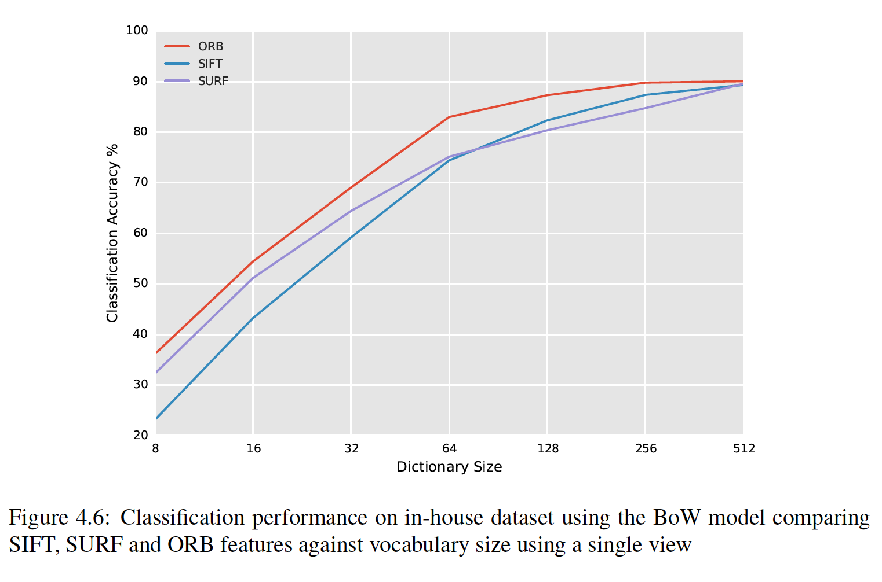
Results: Single View (in-house)
Notes:
-Results ORB outperforms SIFT and SURF over all vocab sizes

Slide 18
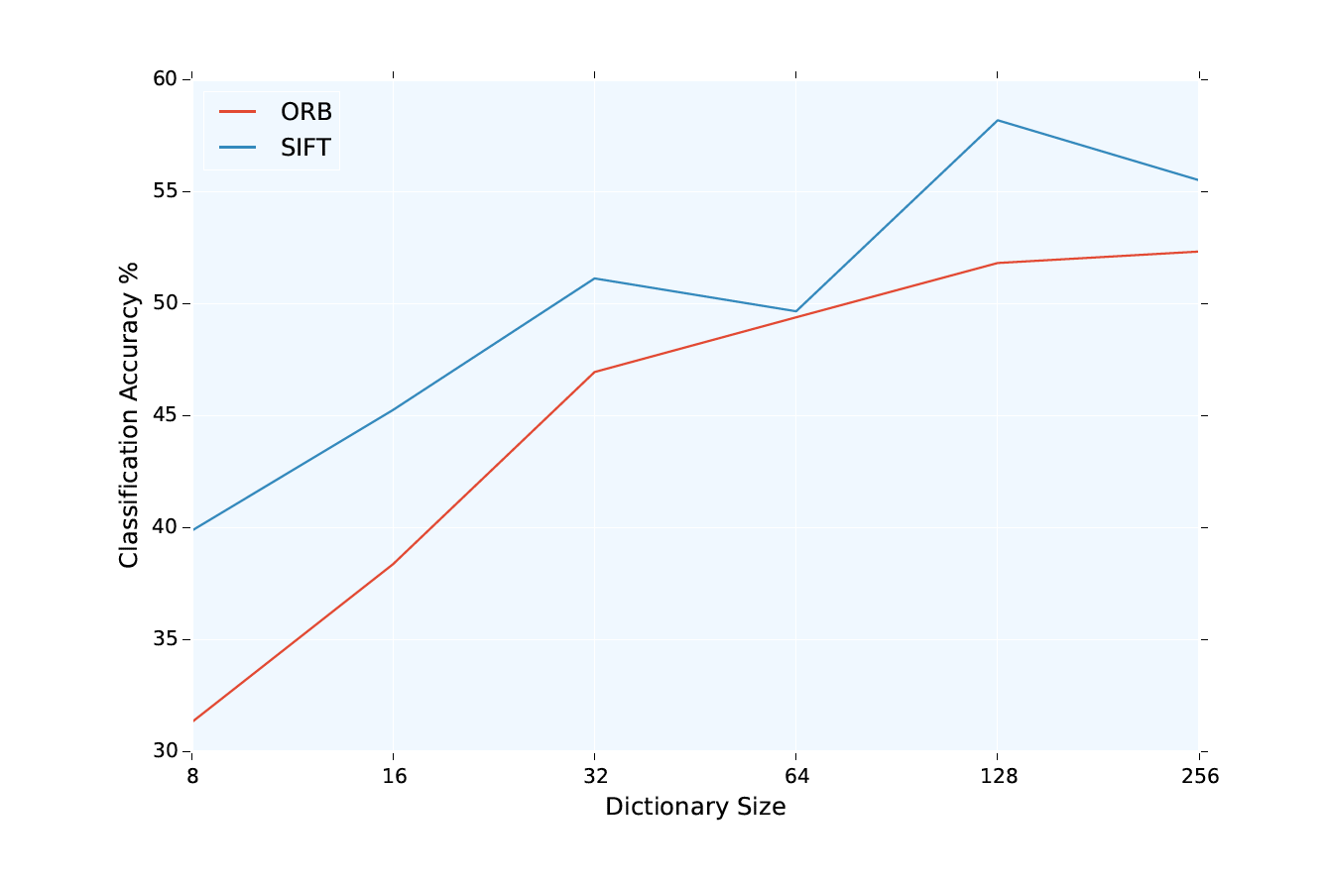
Results: Single View (CalTech)
Notes:
-generalize CV dataset we find SIFT actually performs the best
-

Slide 19
Analysis
ORB showed superior classification performance for in-house dataset but not CalTech:
CalTech dataset had much larger changes in scale and viewing angle
ORB appears to be more suitable in controlled environments
Accuracy as a function of dictionary size:
Diminishing returns
Trade off of increased classification time
ORB showed a classification speed increase of ~6.5x SIFT and ~3.4x SURF
Avoidance of license restrictions – both SIFT & SURF are patent protected

Slide 20
Problem 2 – Single vs Multiple Views
Car parts ~90% classification accuracy
Not acceptable if thousands of parts are processed per day
Discriminating features are occluded
Discriminative physical features may not be visible in the one view
Multi view representation is challenging:
Depth information / 3D reconstruction
Computationally expensive
Many techniques require camera calibration
Feature correspondence is challenging for this particular dataset
Notes:
-hard to match features across multiple views

Slide 21
Problem 2 – Single vs Multiple Views
Proposed simple approach of concatenation of feature vectors over multiple views
Construct a feature vector for each view independently then concatenate
For i =1 to n views:
Fvec := fvec_{i}
21

Slide 22
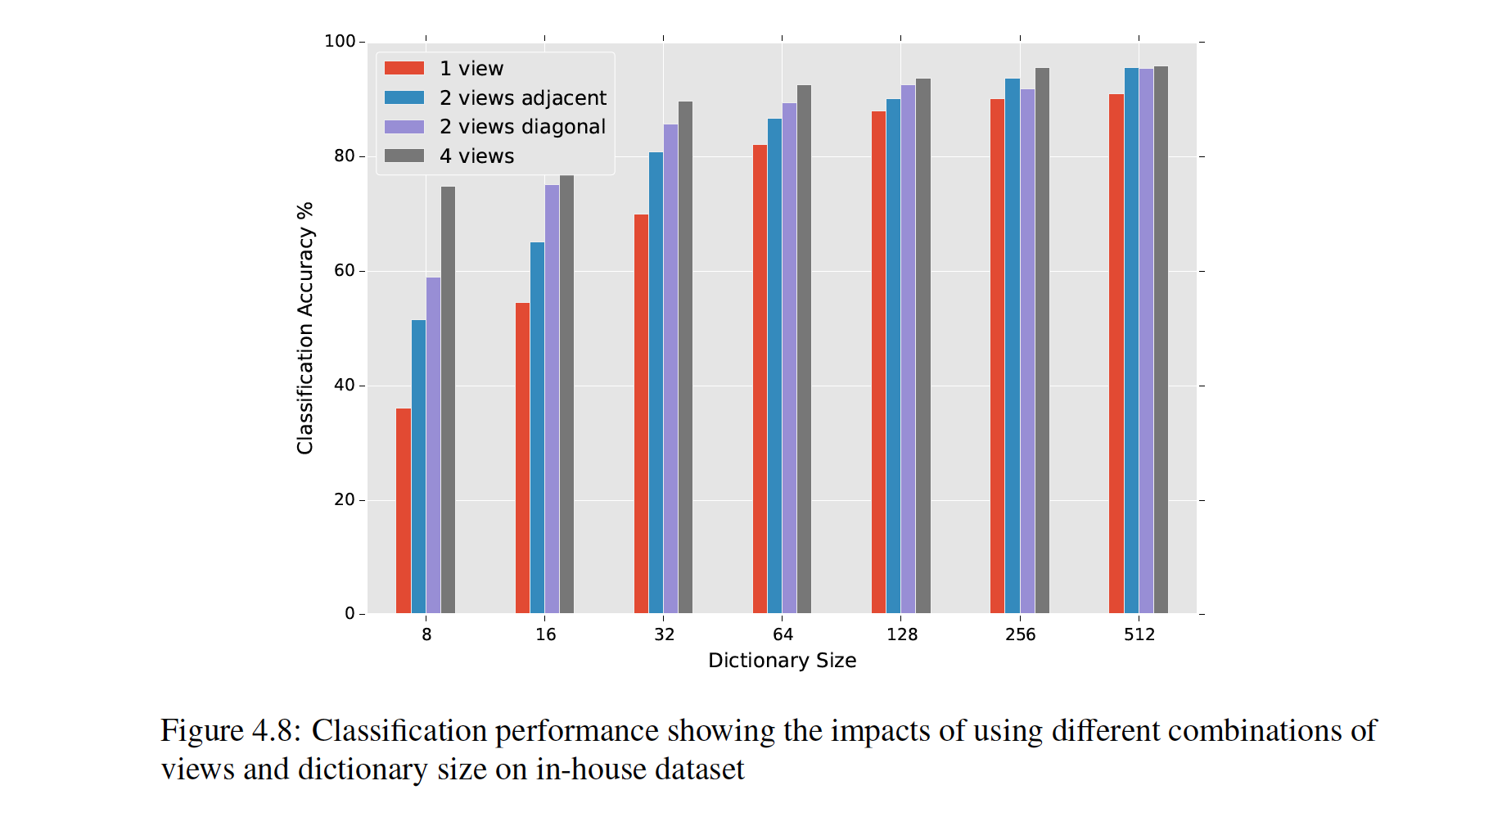
Results – Single vs Multiple views
Notes:
-regardless of dictionary size – more views yields higher accuracy
-about 5% increase from single view
4view -256ds → 95.6% acc
-about 5% increase from single view

Slide 23
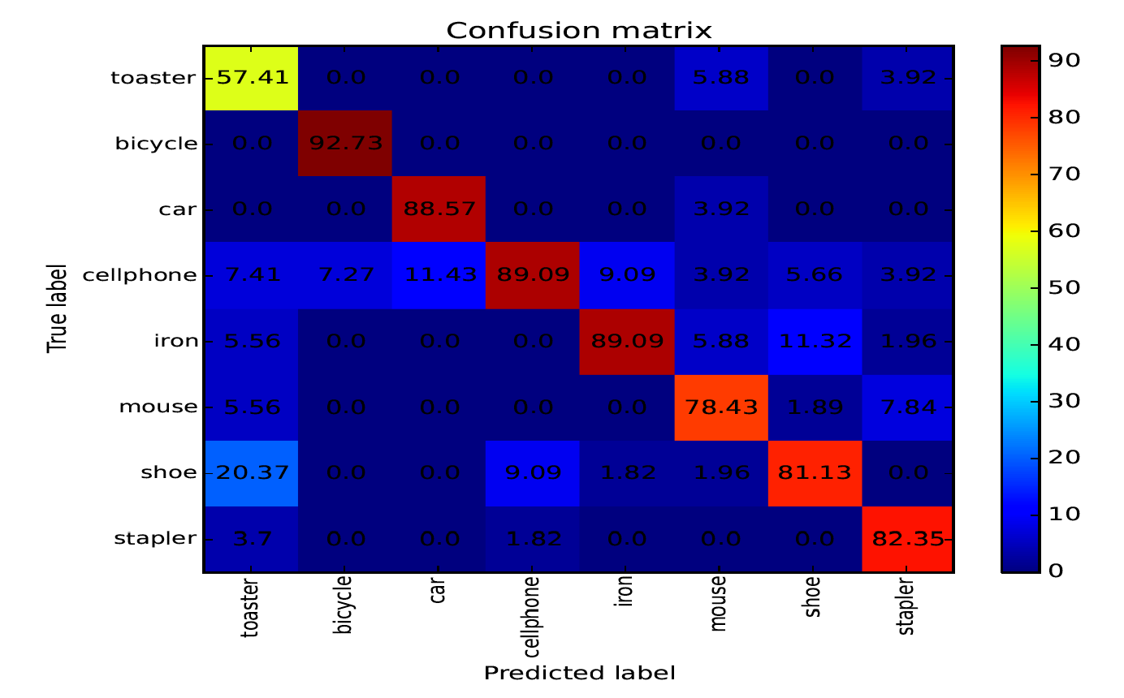
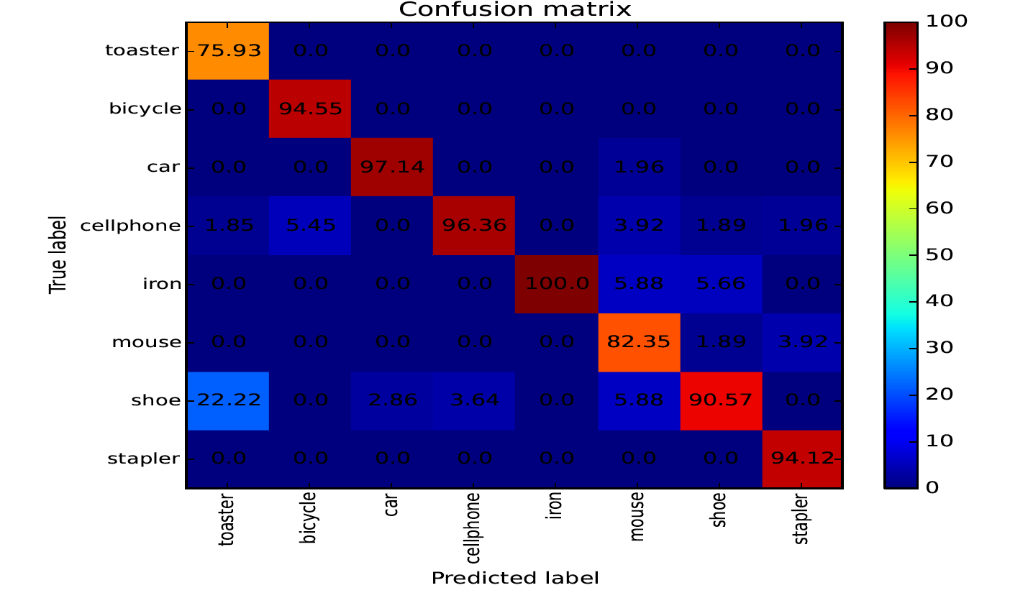
Results – Single vs Multiple views
Notes:
-here is a confusion matrix
-want larger scores to be along diagnoal as it indicates correct classification

Slide 24
Significance
Classification on both datasets improved when there were more views
Increasing the number of views increases the chance of capturing features that helps discriminate among similar objects
Analogous to spatial histograms but incorporates geometry at the view level (next slide)
Notes:
Classification on both datasets improved regardless of dataset – there is a benefit to using this in both MV and CV tasks

Slide 25
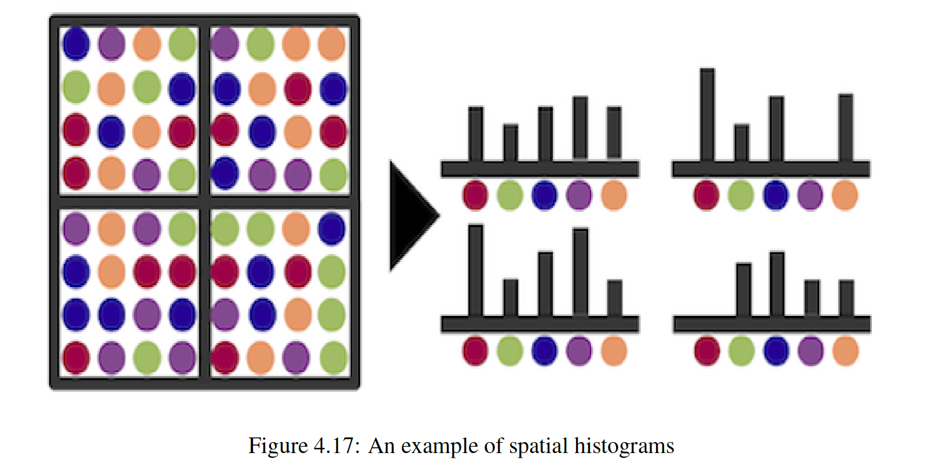
Spatial Histograms
The Bag of Words model is order less representation
Spatial histograms help circumvent this
Notes:
-The bag of words model does not contain any geometric information. The infoof where the feature the feature was found isn’t represented. The information about feature location and where ffeatures are with respect to one another is important
-By partitioning the image and buildinging a feature vector for each grid can help account for this..
-The argument to be made here is that we perform spatial histograms but instead of partitioning the image into grids our partition is at the image level

Slide 26
Spatial Histograms
It is widely understood that spatial histograms improve accuracy
Using this ‘spatial histograms’ among views also achieves this goal

Slide 27
Vector of Locally Aggregated Descriptors
Extension to the Bag of words model
No longer encodes features as just a histogram of word counts
Contains ‘first order information’
Word assignment + distances to centroid
Dimensionality k*d:
k = number of centroids
d = dimensionality of descriptor
Notes:
Extension to the Bag of words model – prozed by researchers at inria
No longer encodes features as just a histogram of word counts -
Contains ‘first order information’
Word assignment + distances to centroid among dimensions

Slide 28
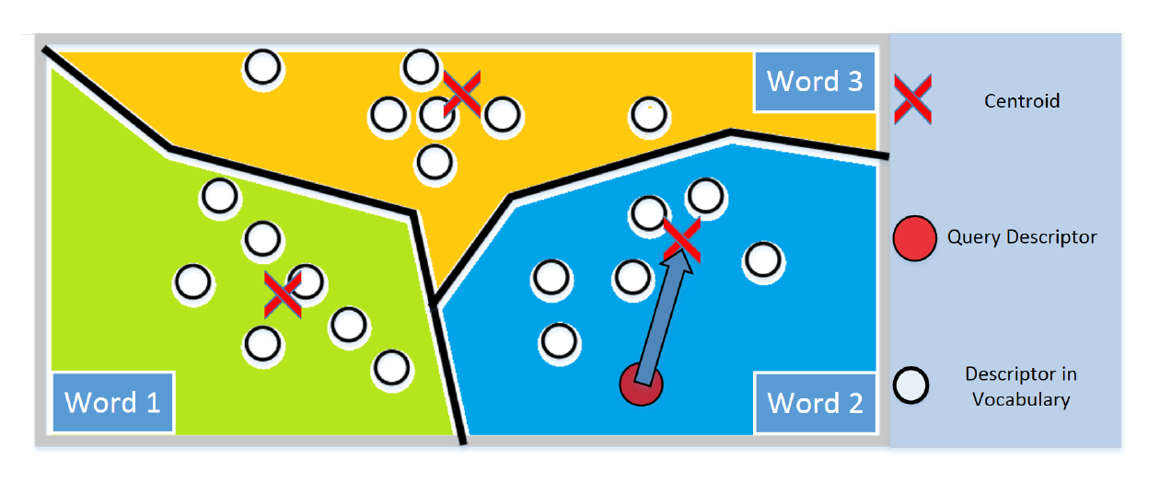
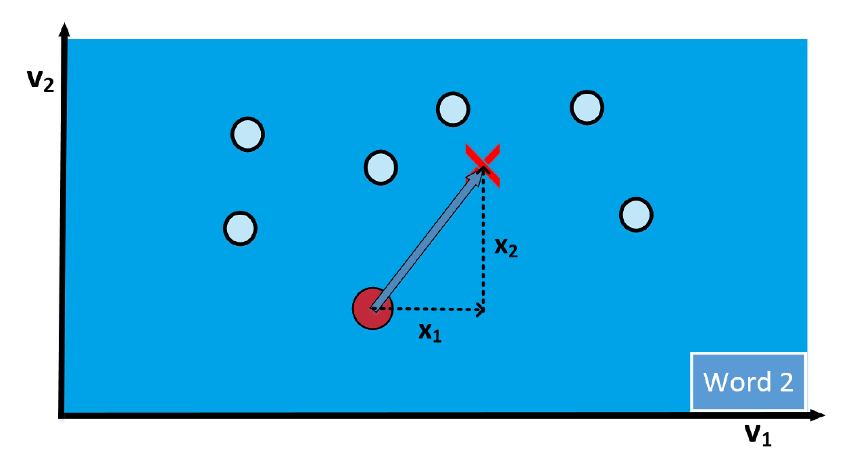
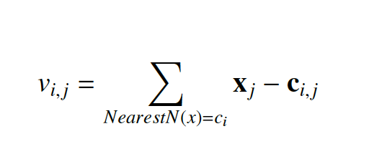
Vector of Locally Aggregated Descriptors
v = [0, 0, x₁, x₂, 0, 0]
Notes:
-Typical bow, you take a descriptor and map to centroid by NN and get the word frequency
-Repeat for all descriptors and build a histogram over word frequencies
-Here we assign descriptor to a centroid but

Slide 29
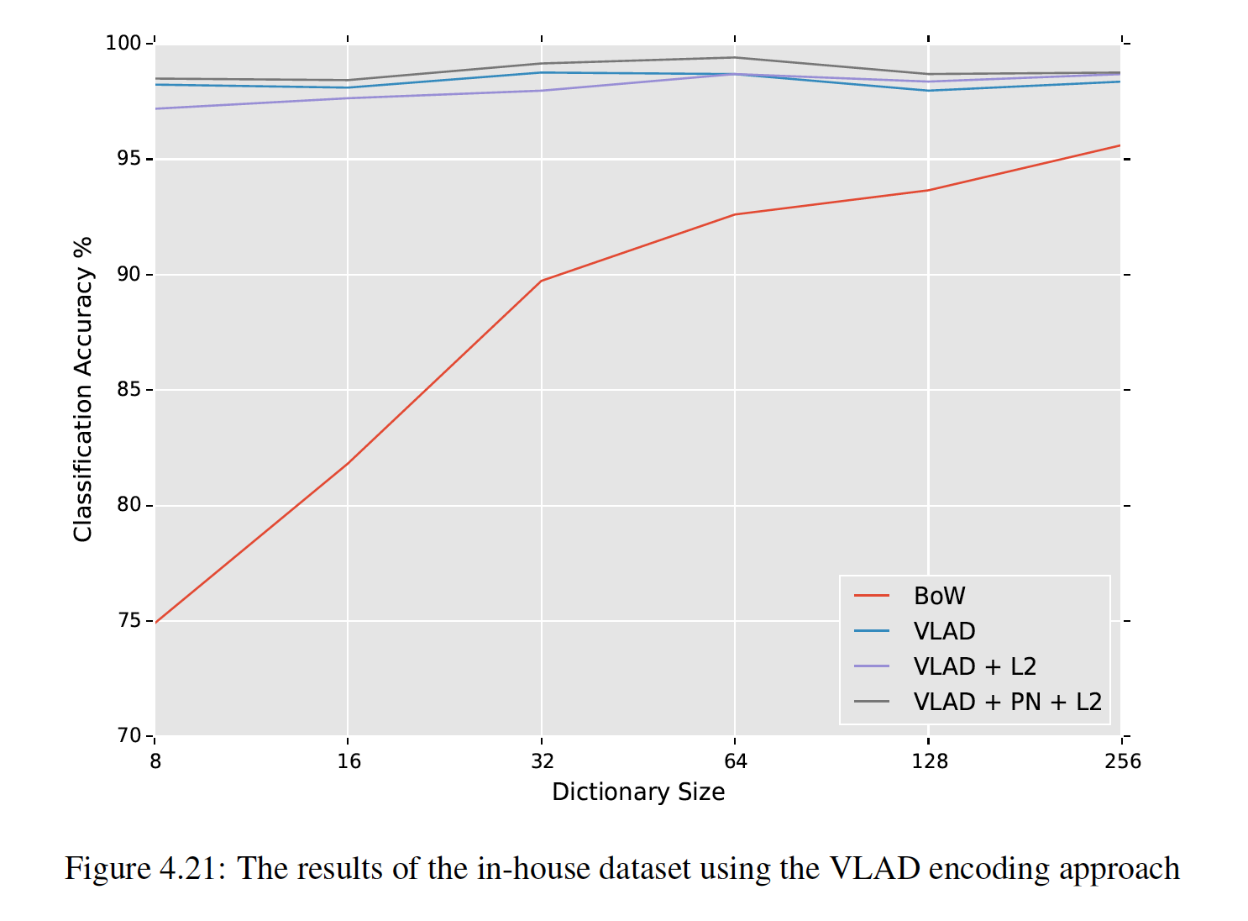
VLAD Experiment
Notes:
-right off the bat outperformed traditional BoW
-greater dimensionality , VLAD has a fvec of 256*32 as opposed to 256 resulting in longer classification

Slide 30
VLAD Results
Great accuracy improvement even when the visual vocabulary is small
Peak accuracy of 99.4% compared to 95.6%
Accuracy is great enough to be of value for machine vision applications
Demonstration that VLAD encoding can be used with multiple views
Evidence that despite being binary, ORB features can still undergo VLAD encoding
Prior works used primarily SIFT
Considerable speedup for training and classification as resulting feature vector is always ¼ that of SIFT

Slide 31
Triangulation Embedding
Extension of the VLAD representation but uses directional information over absolute distances
No longer performs a brute-force search to assign descriptors to centroids – but rather uses residual distances among all words
Two main steps: 1-Embedding and 2-Aggregation

Slide 32
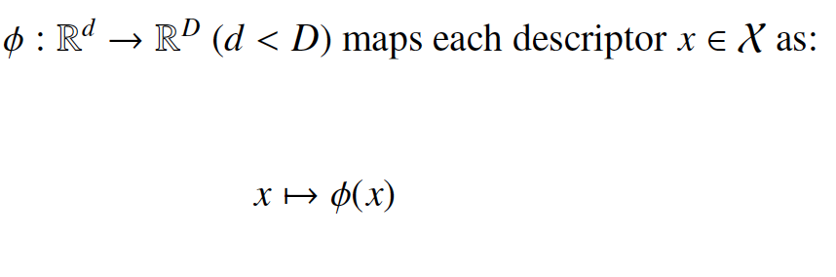
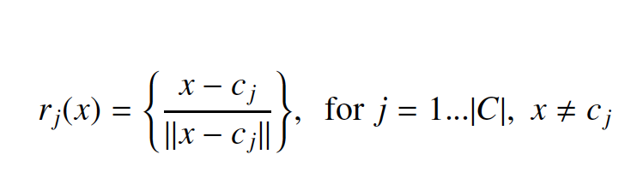
Triangulation Embedding
Embedding:
Define an embedding function
Compute residuals and unit normalize:
Forming the set R(x)
Notes:
-Embedding function maps each descriptor in the image
-residual distances of a descriptor and centroids are computed
-each residual is unit normed -> hence the term ‘triangulation’

Slide 33
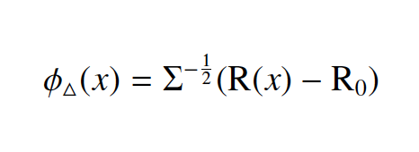
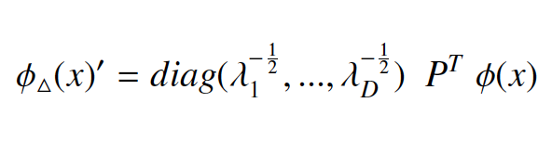
Triangulation Embedding
The set of residuals then undergo a whitening process: center, scale and rotate
R₀ = E_{X}[R(x)] and Σ – covariance matrix both learned on a training set → looks very similar to PCA

Slide 34
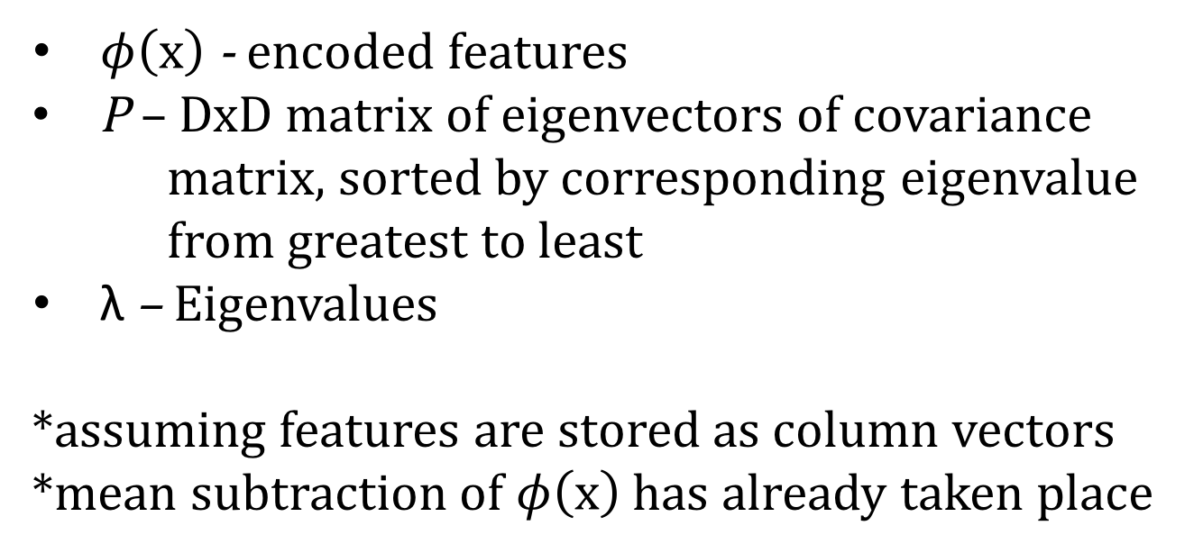
Triangulation Embedding
$φ\left(x\right)$ - encoded features
P – DxD matrix of eigenvectors of covariance matrix, sorted by corresponding eigenvalue from greatest to least
$\text{λ}$– Eigenvalues
*assuming features are stored as column vectors
*mean subtraction of $φ\left(x\right)$ has already taken place

Slide 35
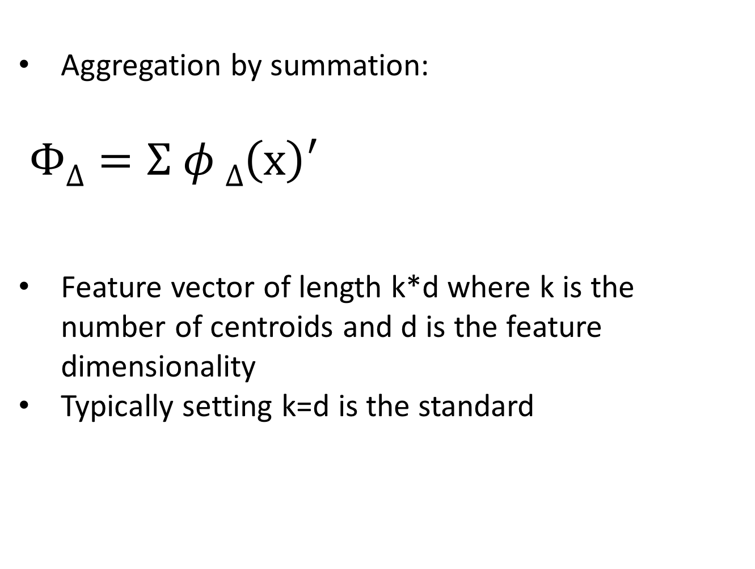
Triangulation Embedding
Aggregation by summation:
$$Φ\text{Δ}=Σ φ \text{Δ}\left(x\right)′$$
Feature vector of length k*d where k is the number of centroids and d is the feature dimensionality
Typically setting k=d is the standard
Notes:
-Last stage is aggregation by summation
-

Slide 36
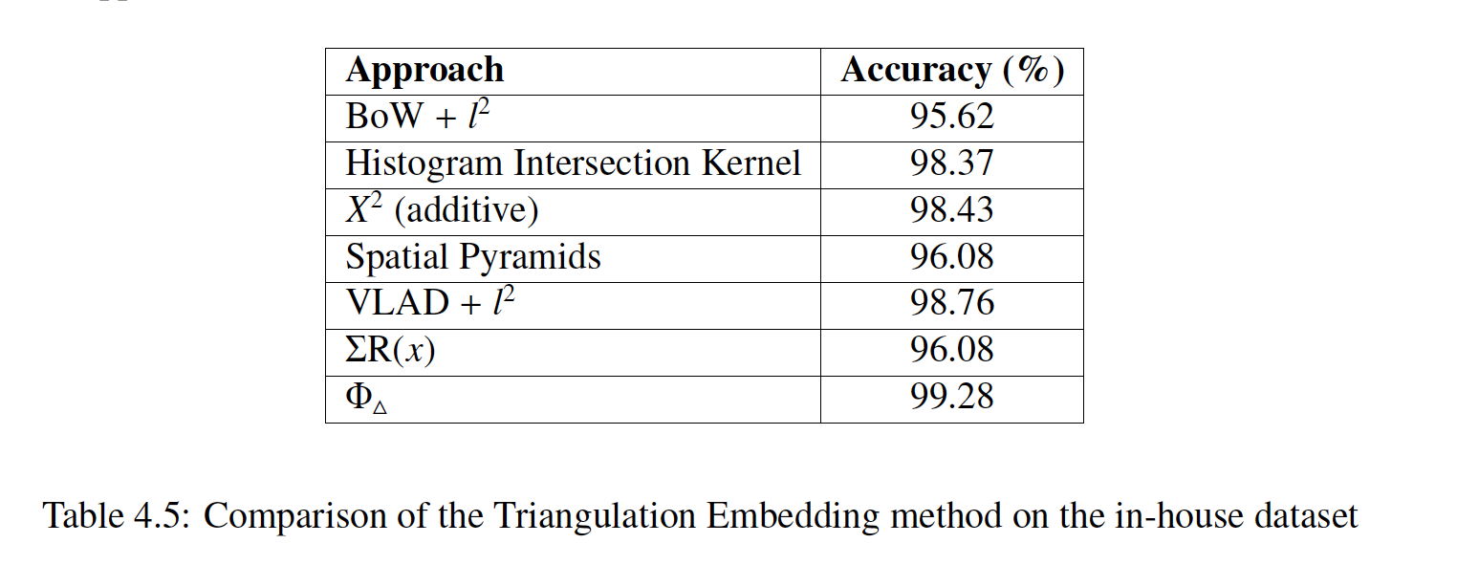
Triangulation Embedding Results
Notes:
-3 discussed encoding methods Triangulation emb performed the best
-without the whitening – limited value in TE as whitening decoraltes the data

Slide 37
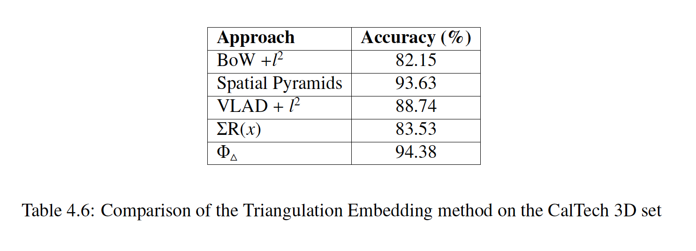
Triangulation Embedding Results

Slide 38
Triangulation Embedding Analysis
The comparison of images is done by use of a similarity score:
Compared by feature vectors
Cosine similarity is the most common metric
Similarity is between [0 – 1] from least to most similar
Classification is ideal when an instance is similar to its members within the same class and dissimilar to objects of other classes

Slide 39
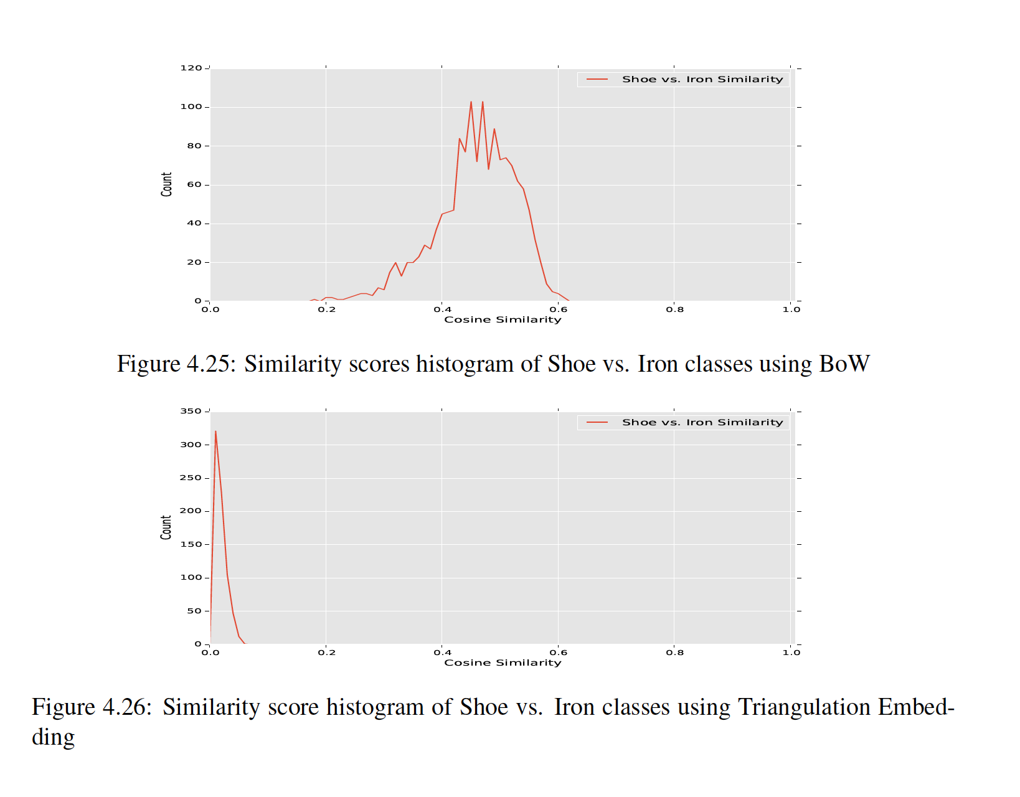
Triangulation Embedding Analysis

Slide 40
Triangulation Embedding Significance
Outperforms other encoding methods
Better accuracy then BoW & VLAD
Best accuracy on both datasets
This method generates a more discriminative feature vector
This encoding method is nearly guaranteed to perform better over the standard BoW model

Slide 41
Camera Downtime
All machines break down eventually
Harsh manufacturing environments:
Dust
Heat
Physical damage
Strenuous use (i.e. running 24x7)
Downtime can stop inspection or manufacturing

Slide 42
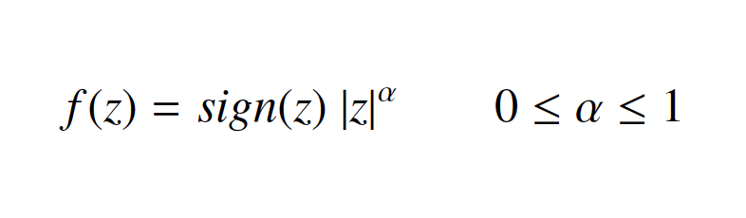
Camera Downtime
Propose to see how well the system can maintain classification by disabling an input on a random view
Apply power-law normalization to handle bursty features
Power-law normalization (PN):

Slide 43
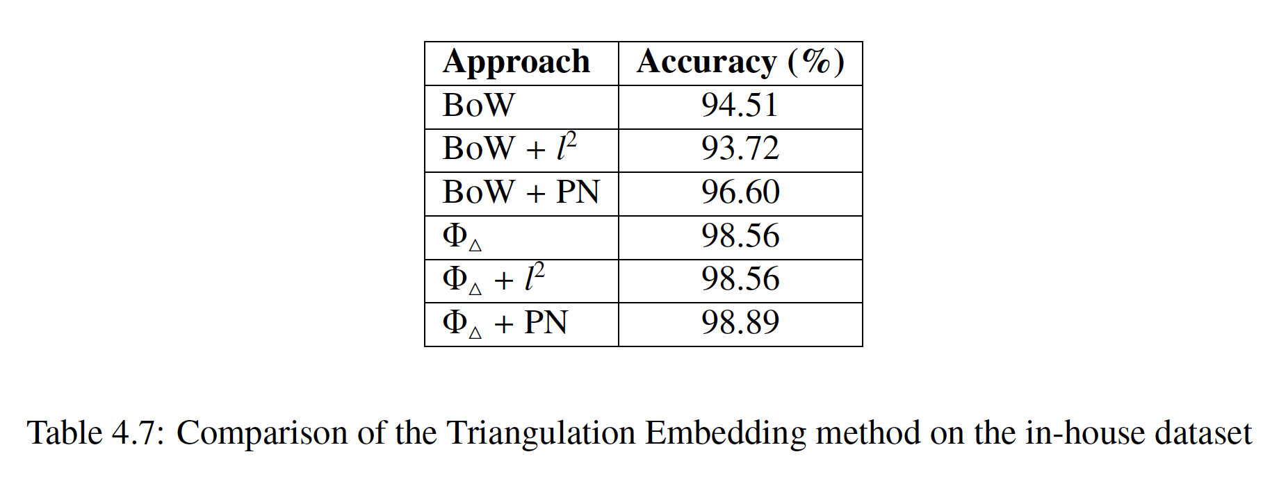
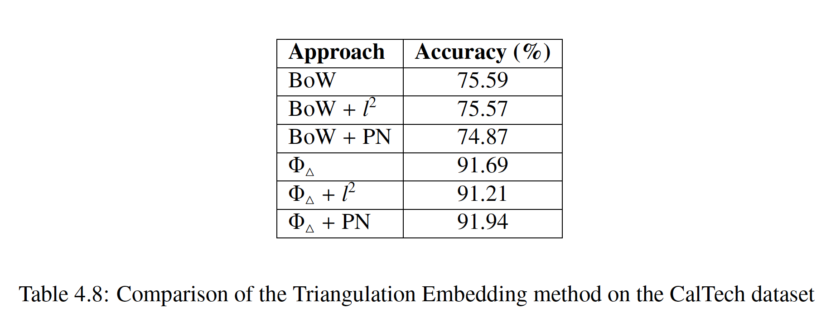
Camera Downtime Results
Notes:
-liblinear
-minor drop in house from 99.28 to 99.89
-minor drop in calTech 94.38 to 91.94

Slide 44
Camera Downtime Significance
Minor decrease in accuracy in the event of a damaged camera:
Indicates a damaged input would not have to result in disabling the vision system
In-house dataset only experienced a 0.6% drop in accuracy using triangulation embedding method with a missing input
On both datasets the reduction in accuracy was only half that compared to the BoW method
Notes:
-liblinear
-minor drop in house from 99.28 to 99.89
-minor drop in calTech 94.38 to 91.94

Slide 45
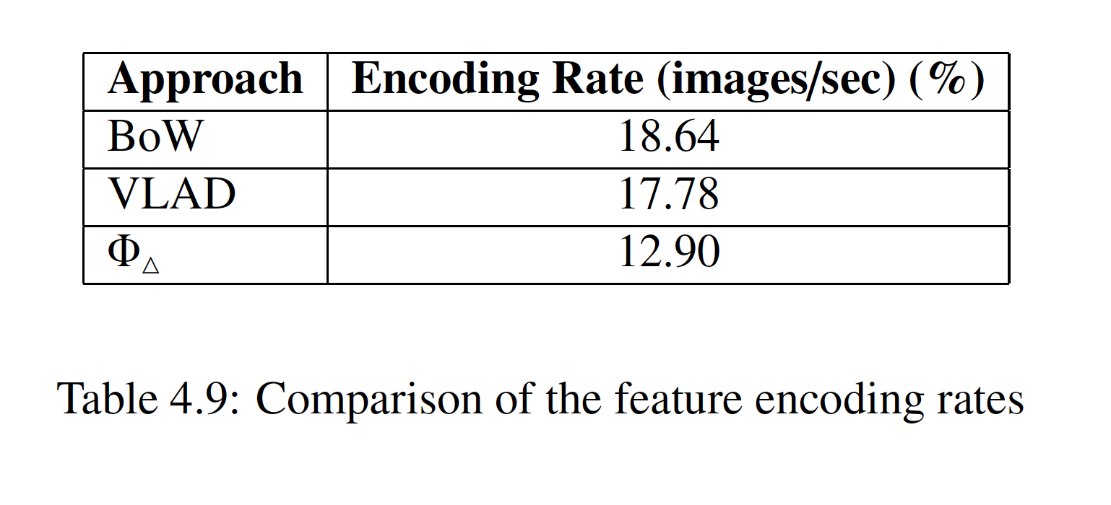
Encoding Rates
The time it takes from feature detection to generating a final feature vector
Intel i7 machine using Python3 with openCV & Numpy libraries

Slide 46
Conclusions
This work evaluated the usefulness of the binary ORB features and how it compares to SIFT and SURF
The presentation of a framework for a machine vision systems for object identification
This framework is extended to use multiple views while also evaluating newer feature encoding strategies that greatly outperform the traditional BoW model

Slide 47
Conclusions
The system itself can classify fine-grained object categories at near real-time speeds
The vision system is robust enough to handle a damaged camera without disrupting operations
Engineering perspective:
Improved quality control
Addressed the risk of possible component failure
Designed an inexpensive solution – total cost of cameras ~$400

Slide 48
Future Work
Integration of depth sensors
Convolutional Neural Networks
Increase processing speed:
GPU computing
Evaluate ORB descriptors in Hamming Space

Slide 49

Acknowledgements
Dr. Samarabandu & Dr. Wang
Sightline Innovation Inc.

Slide 50
Q&A

Slide 51


